Slide 1
Deep Neural Networks

Slide 2
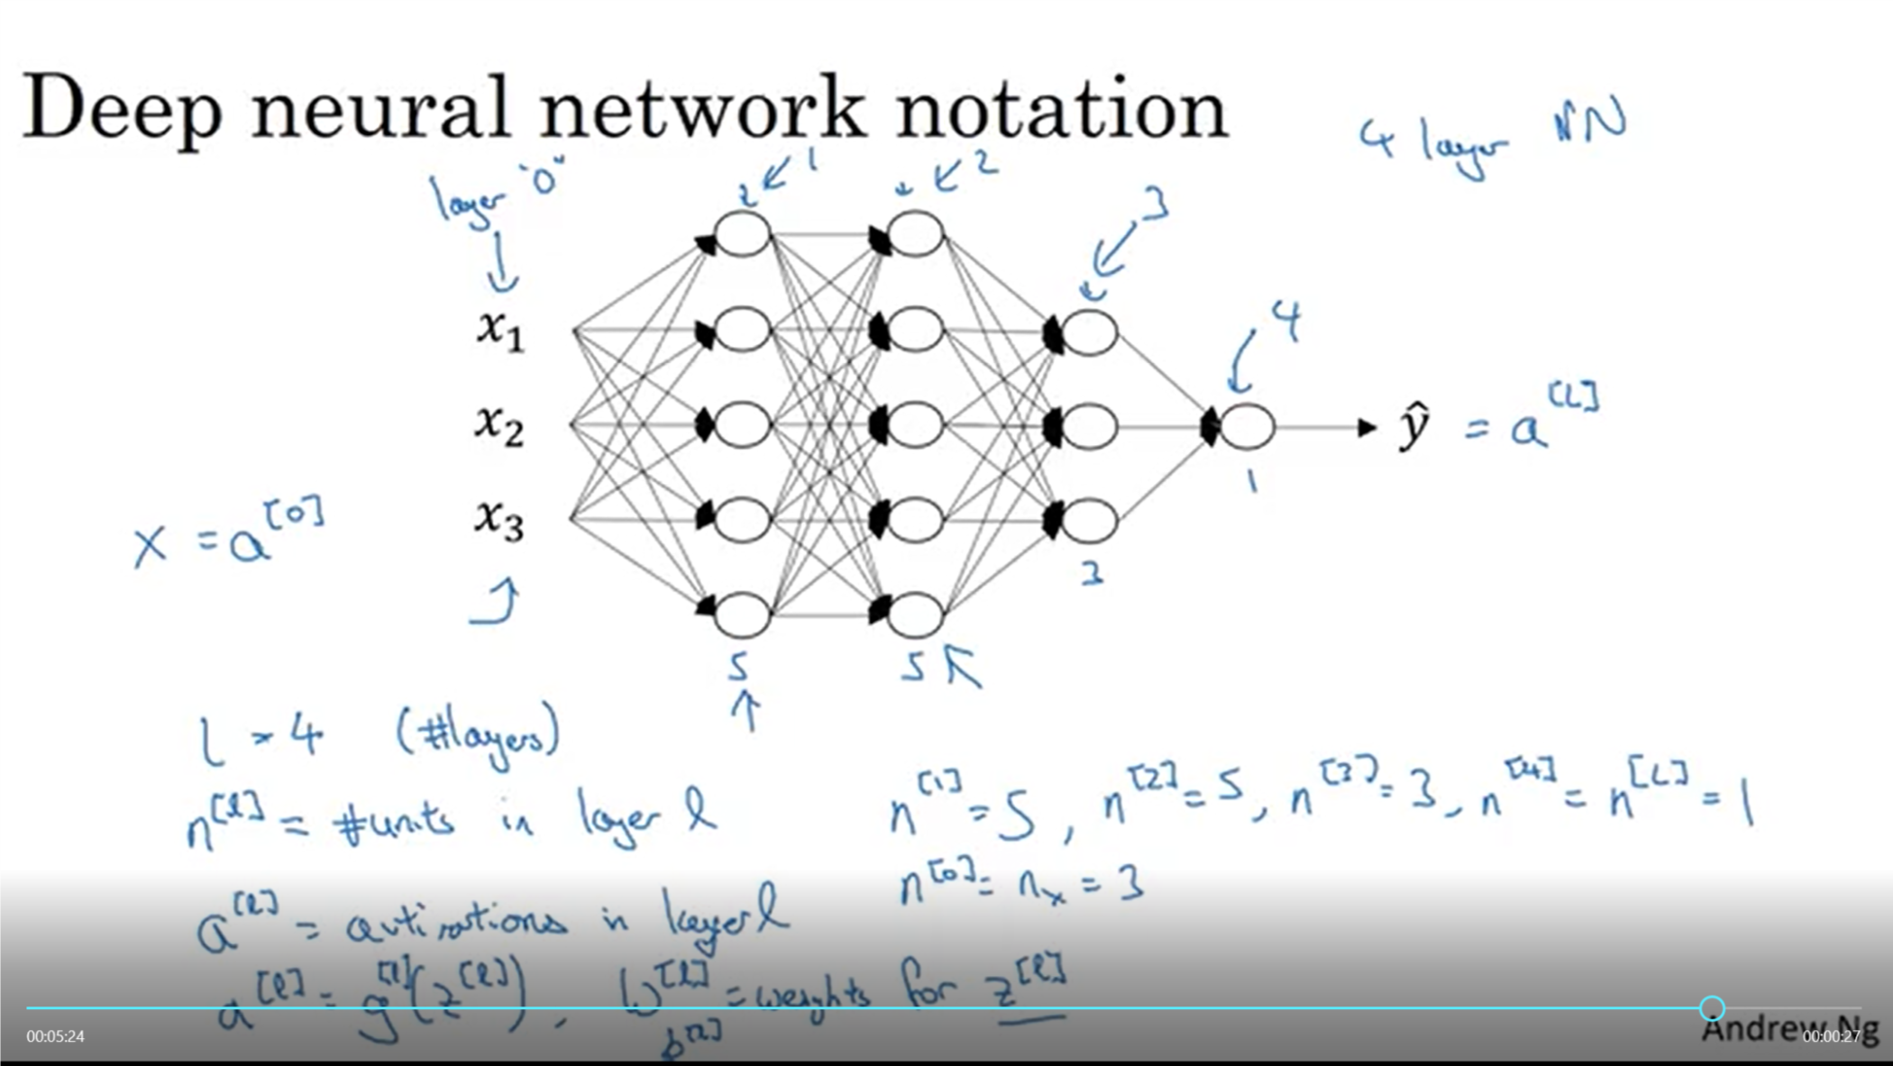
What is a DNN

Slide 3
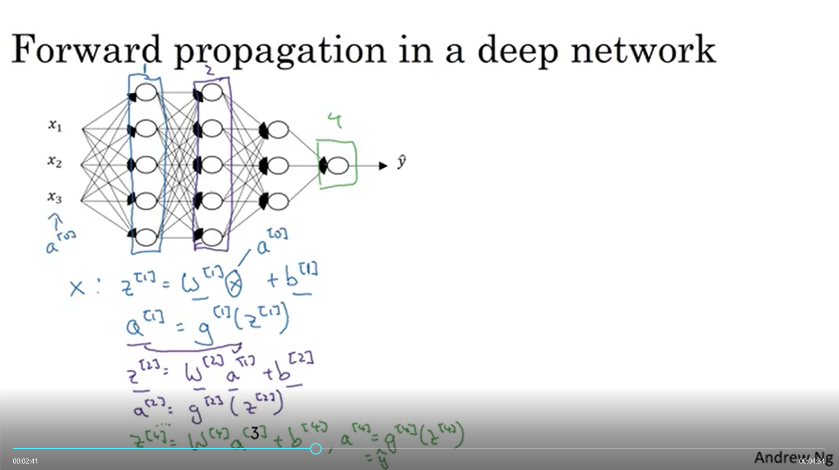
Forward Propagation in a DNN

Slide 4
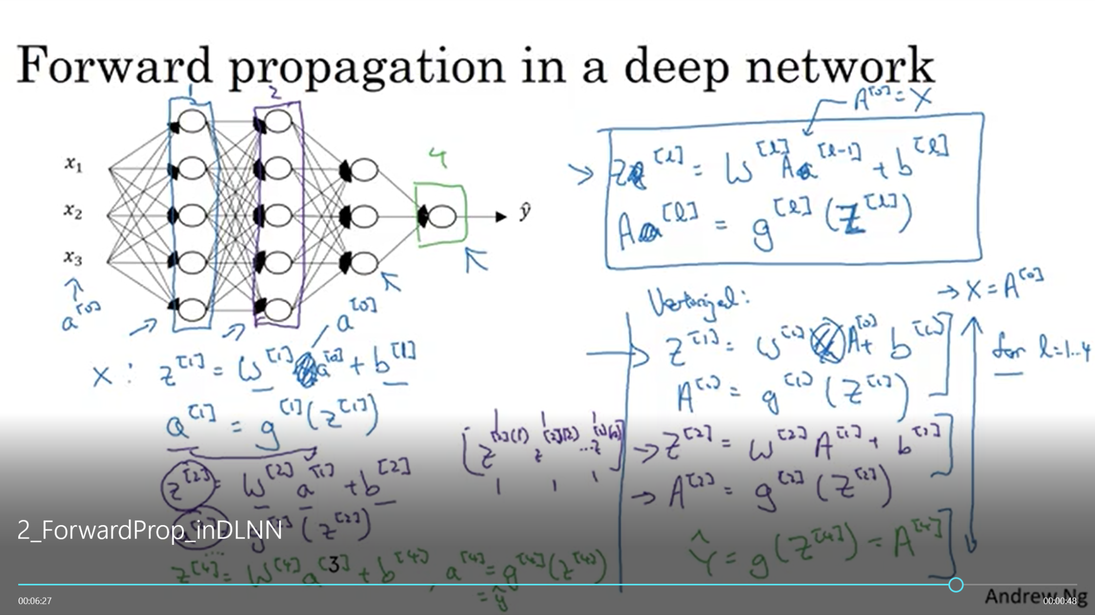
Forward 2

Slide 5
Deep Neural Networks
Getting your matrix
dimensions right

Slide 6
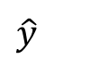
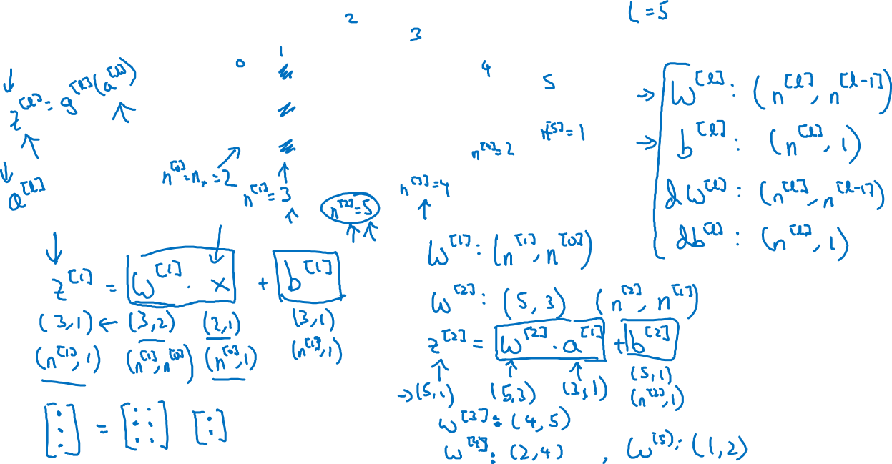

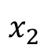
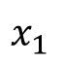
Parameters $W^{[l]}$ and $b^{[l]}$
$$x_{1}$$
$$\hat{y}$$
$$x_{2}$$

Slide 7
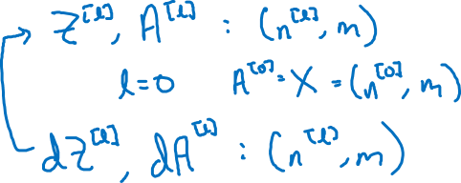
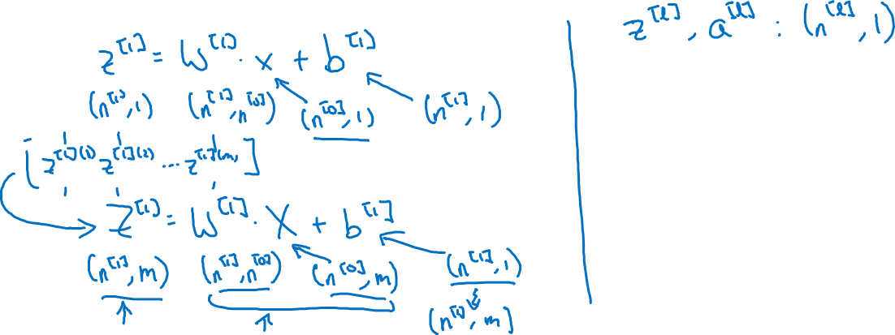
Vectorized implementation
$$x_{1}$$
$$\hat{y}$$
$$x_{2}$$

Slide 8
Deep Neural Networks
Why deep
representations?

Slide 9

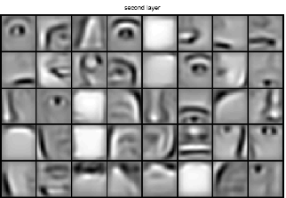
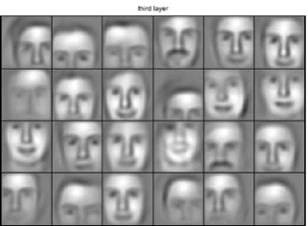
Intuition about deep representation
$$\hat{y}$$

Slide 10
Circuit theory and deep learning
Informally: There are functions you can compute with a “small” L-layer deep neural network that shallower networks require exponentially more hidden units to compute.

Slide 11
Deep Neural Networks
Building blocks of
deep neural networks

Slide 12
Forward and backward functions
$$x_{1}$$
$$x_{2}$$
$$\hat{y}$$
$$x_{3}$$
$$x_{4}$$

Slide 13
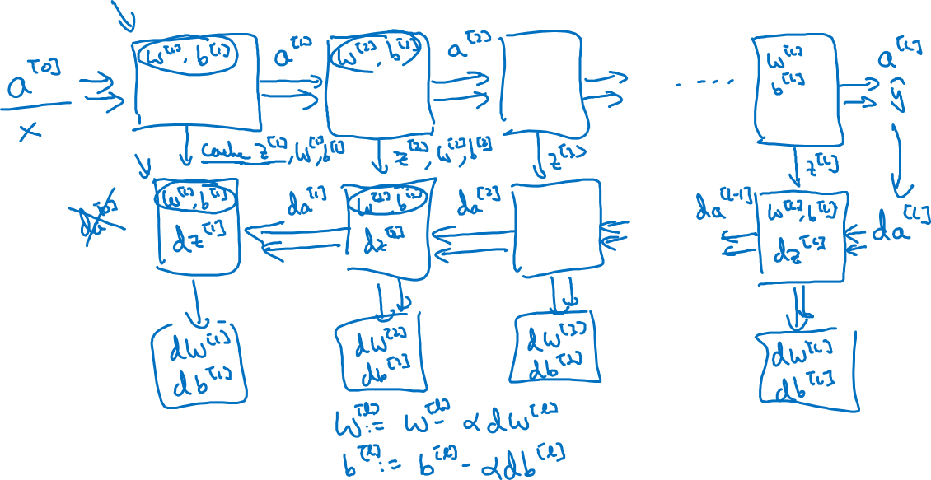
Forward and backward functions

Slide 14
Deep Neural Networks
Forward and backward
propagation

Slide 15
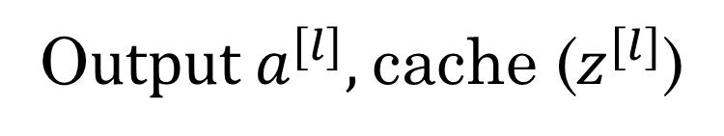
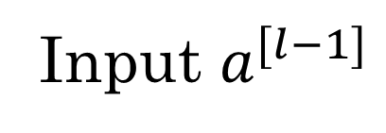
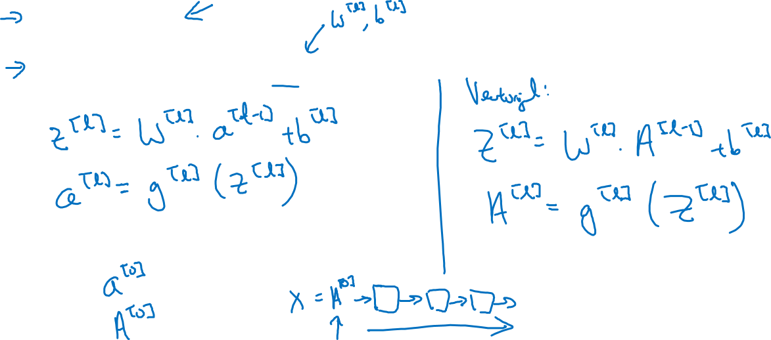
Forward propagation for layer l
Input $a^{[l−1]}$
O$utput a^{[l]},$cache ($z^{[l]}$)

Slide 16
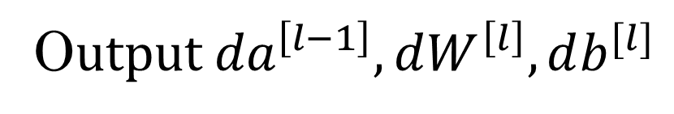
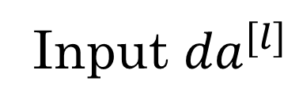
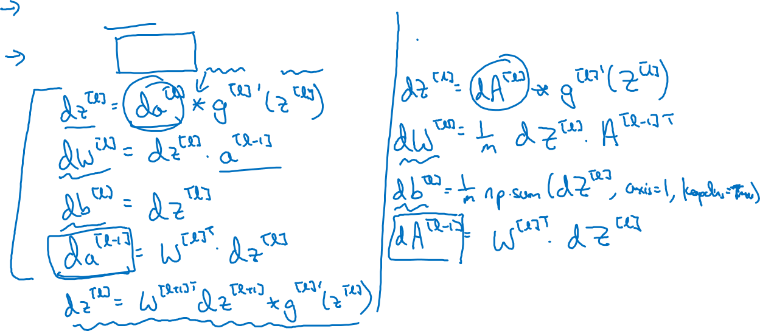
Backward propagation for layer l
Input ${da}^{[l]}$
O$utput {da}^{\left[l−1\right]},dW^{\left[l\right]},db^{[l]}$

Slide 17
Deep Neural Networks
Parameters vs
Hyperparameters

Slide 18
What are hyperparameters?
Parameters: $W^{\left[1\right]} ,{ b}^{\left[1\right] }, W^{\left[2\right]} ,b^{\left[2\right] },W^{\left[3\right] }, b^{\left[3\right] }…$

Slide 19

Applied deep learning is a very empirical process
Idea
cost $J$
Experiment
Code
# of iterations

Slide 20
Deep Neural Networks
What does this
have to do with
the brain?

Slide 21
Forward and backward propagation
For example the first activation functions could be ReLU and the last one
Could be sigmoid
$$Z^{[1]}=W^{[1]}X+b^{[1]}$$
$${dZ}^{[L]}=A^{[L]}−Y$$
$$A^{[1]}=g^{\left[1\right]}(Z^{\left[1\right]})$$
$$dW^{[L]}=\frac{1}{m}dZ^{\left[L\right]}A^{{\left[L\right]}^{T}}$$
$$Z^{[2]}=W^{[2]}A^{[1]}+b^{[2]}$$
$$db^{[L]}=\frac{1}{m}np. sum(dZ^{\left[L\right]},axis=1, keepdims=True)$$
$$A^{[2]}=g^{\left[2\right]}(Z^{\left[2\right]})$$
…
$${dZ}^{[L−1]}=dW^{{\left[L\right]}^{T}}dZ^{\left[L\right]}{g^{′}}^{\left[L\right]}(Z^{\left[L−1\right]})$$
$$A^{[L]}=g^{\left[L\right]}\left(Z^{\left[L\right]}\right)=\hat{Y}$$
…
$${dZ}^{[1]}=dW^{{\left[L\right]}^{T}}dZ^{\left[2\right]}{g^{′}}^{\left[1\right]}(Z^{\left[1\right]})$$
$$dW^{[1]}=\frac{1}{m}dZ^{\left[1\right]}A^{{\left[1\right]}^{T}}$$
$$db^{[1]}=\frac{1}{m}np. sum(dZ^{\left[1\right]},axis=1, keepdims=True)$$
Align left/vertical will mess up the equations here

